Slide 1
Bayesian Binary Regression in Marketing
A Project to assess Response rates in DM campaigns

Slide 2
Abstract
In this project we attempt to assess the application of Bayesian methods to the marketing field. In the magazine industry making a customer renew his subscription is critical as it has a crucial financial impact. The response variable is binomial as he may either renew the subscription or decline. The predictor variables may be continuous or categorical. In such cases logistic regression provides a way to link the binomial outcome to continuous or categorical predictor variables. Bayesian Binomial regression defers from the normal logistic regression in the sense that it makes use of priors of the coefficients of the predictor variables in arriving at the posterior distribution of probability. In this project we attempt to discover the relationship between age as a predictor variable and successful subscription as the response variable using Bayesian Binary Regression.

Slide 3
Background
Print magazine industry is very niche- limited number of customers
Need to retain existing readers is very high
Magazine industry runs several DM campaigns to retain existing subscribers(readers)
With attractive discounts and offers

Slide 4
Industry Challenges
A list is drawn up every month
A campaign is created
Magazine runs the campaign through:
Tele-calling
Direct Mailer
SMS
Response rates( people who subscribe) is low
Even increasing it by 1% can have big impact on revenues

Slide 5
Project Outline
Objective: propose to assess the relationship between age of the target subscriber and the outcome( subscribed vs not subscribed).
If the relationship is established, we can then assign a probability score to prospective subscribers and approach only those with a high probability score

Slide 6
Project challenge
It is not possible to use ‘Linear regression’ to predict the outcome
Reasons:
Predictor variable (age) is continuous
Outcome is binomial( with values of 1 for subscribed and 0 for not subscribed)

Slide 7
Scatterplot of the renewal status as a function of the predictor variable ( age)
The outcome falls on two distinct line at 0 or 1
Linear regression cannot capture the relationship

Slide 8
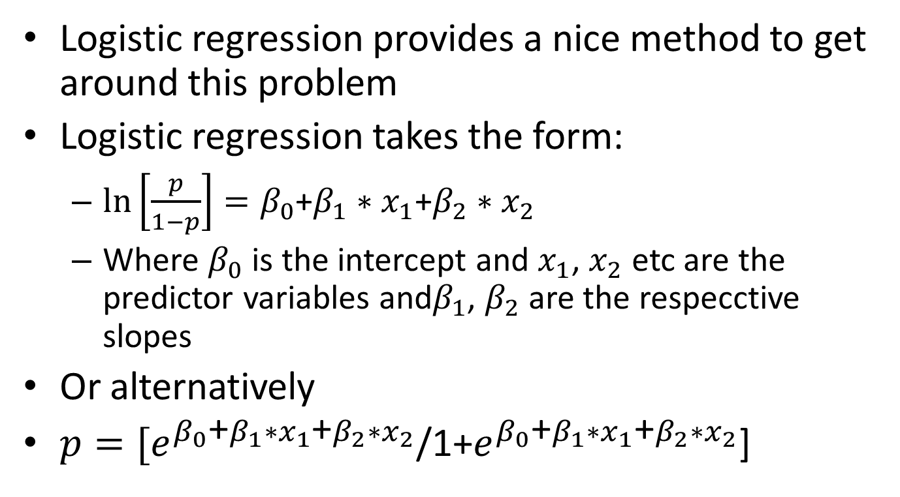
Logistic regression provides a nice method to get around this problem
Logistic regression takes the form:
$\ln\left[\frac{p}{1−p}\right]=β_{0}$+$β_{1}∗x_{1}$+$β_{2}∗x_{2}$
Where $β_{0}$ is the intercept and $x_{1}$, $x_{2}$ etc are the predictor variables and$β_{1}$, $β_{2}$ are the respecctive slopes
Or alternatively
$p=[e^{β_{0}\text{+}β_{1}∗x_{1}\text{+}β_{2}∗x_{2}}$/1+$e^{β_{0}\text{+}β_{1}∗x_{1}\text{+}β_{2}∗x_{2}}$]

Slide 9
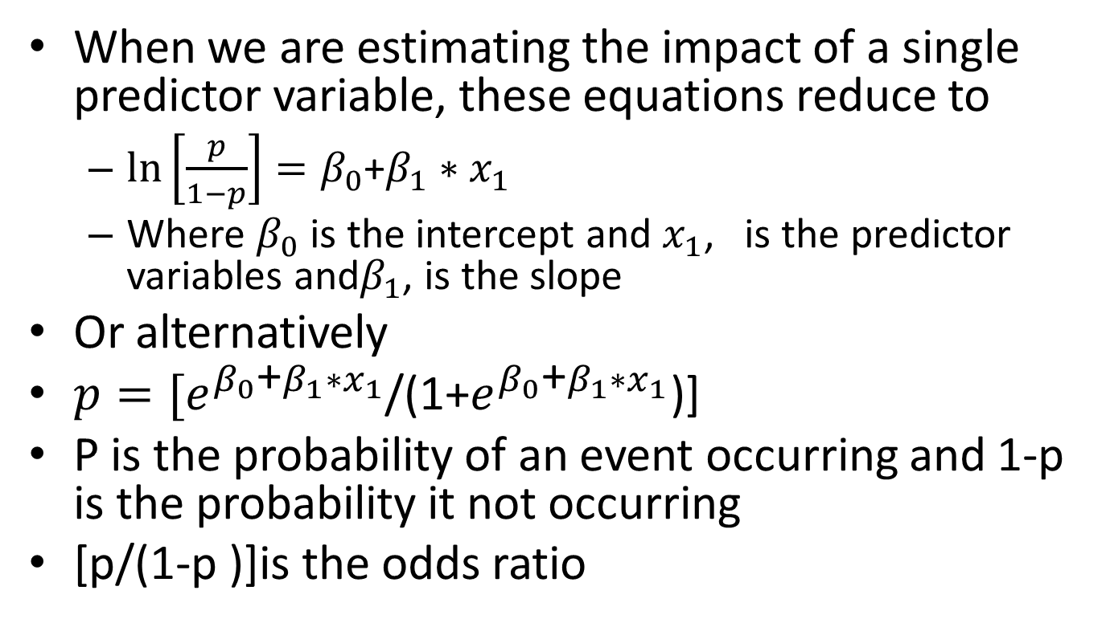
When we are estimating the impact of a single predictor variable, these equations reduce to
$\ln\left[\frac{p}{1−p}\right]=β_{0}$+$β_{1}∗x_{1}$
Where $β_{0}$ is the intercept and $x_{1}$, is the predictor variables and$β_{1}$, is the slope
Or alternatively
$p=[e^{β_{0}\text{+}β_{1}∗x_{1}}$/(1+$e^{β_{0}\text{+}β_{1}∗x_{1}}$)]
P is the probability of an event occurring and 1-p is the probability it not occurring
[p/(1-p )]is the odds ratio

Slide 10
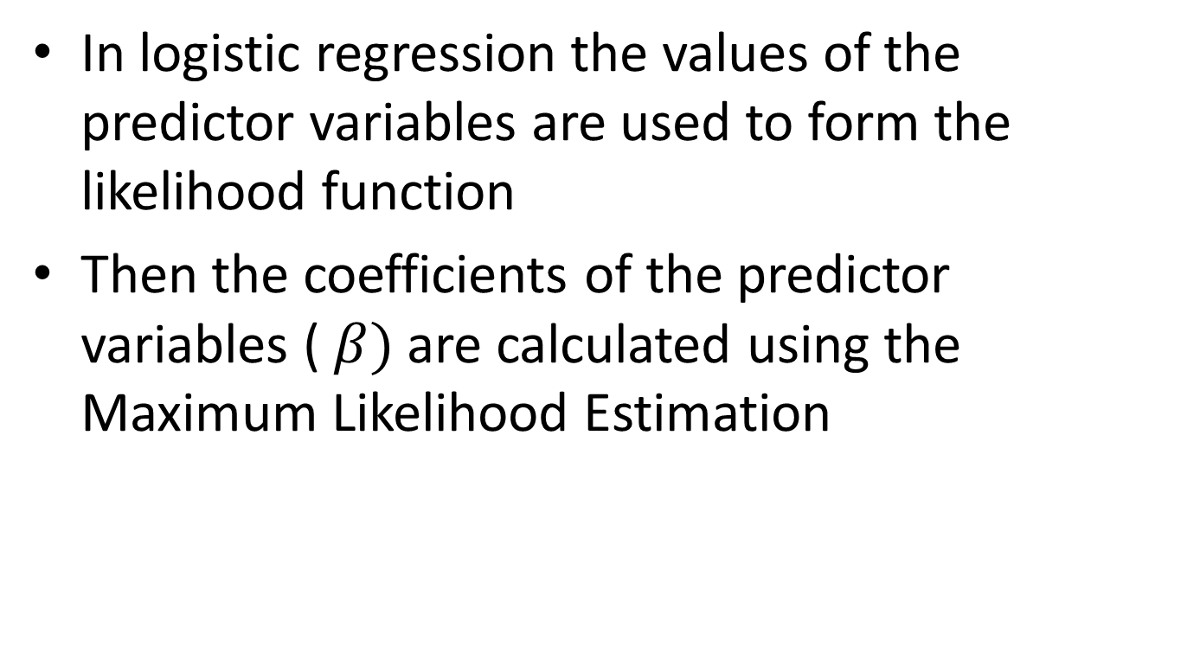
In logistic regression the values of the predictor variables are used to form the likelihood function
Then the coefficients of the predictor variables ( $β)$ are calculated using the Maximum Likelihood Estimation

Slide 11
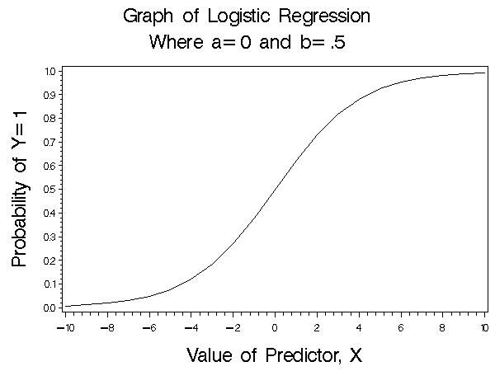
When the predictor values are complete the logistic regression curve produces the graph similar to the on the right
For continuously varying x, the probability values vary between 0 and 1

Slide 12
We have relied on three references in attempting this project
Application of Bayesian Methods in marketing have been extensively studied by professor Rossi.
We have drawn upon the book Bayesian Statistics and Marketing by PE Rossi GM Allenby and R McCulloch, 2005
We also referred to thesis by Mr.Chen Wei
Predicting Customer Response to Direct Marketing- A Bayesian Approach by Chen Wei, 2007
Bayesian Logistic Models for Credit Scoring – A thesis paper by Gregg Weber (Rhodes University)
These documents provide a detailed description of Bayesian method in Direct Marketing and the latter two specifically deal with the application of binary logistic regression with bayes

Slide 13
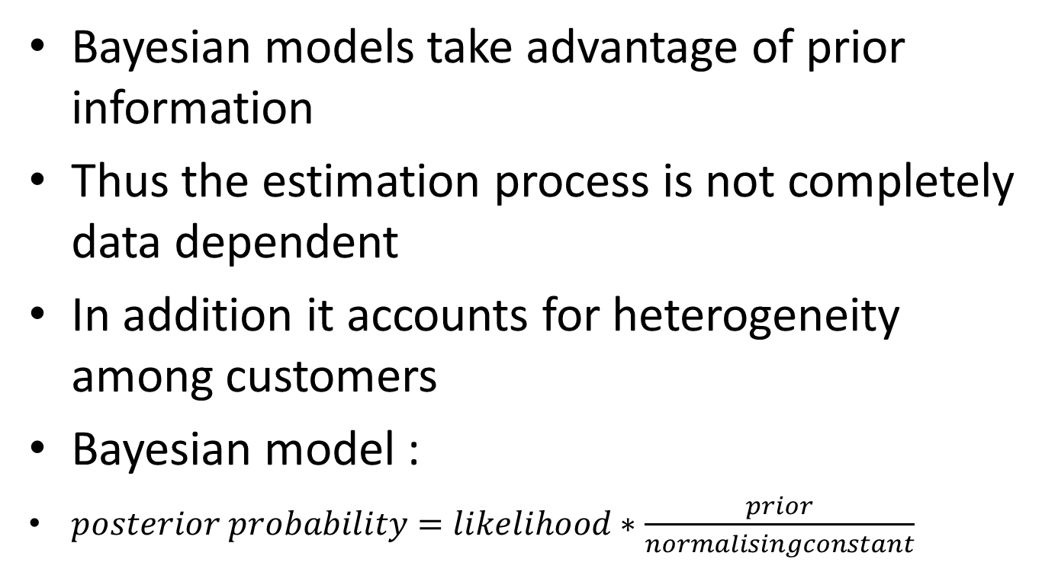
Bayesian models take advantage of prior information
Thus the estimation process is not completely data dependent
In addition it accounts for heterogeneity among customers
Bayesian model :
$posterior probability=likelihood∗\frac{prior}{normalisingconstant}$

Slide 14

Bayesian Binary Regression incorporates the prior into the binary regression
P(r=1|$x_{i}$)= $P\left(r=1\right)∗\prod_{i=1}^{n}{P(x_{i}}$|r=1)

Slide 15
Scope
Our study took real life data from a magazine
Data of subscribers who responded to a direct marketing campaign were collected
The data consisted of the following information:
Among the above we decided to study the impact of age on the response variable
There were roughly 500 records each from 3 campaigns

Slide 16
Detailed information on the data:
Data from 3 campaigns were collected
Roughly 500 records were provided by the organization for the data analysis
Response variable- subscribed ( yes=1) and (no=0)
Predictor variable used Age( from 20 years right upto 51 years

Slide 17
Objective of the study: Assess the relationship between age and response rate
See if we can develop a model to predict the response rates for future campaigns

Slide 18
Methodology:
Step1: Work out a Bayesian binary regression using excel
Step 2: Work out a Bayesian binary regression using excel and grouped data
Step 3: Attempt a Bayesianbinary regression using R
Step 4:Attempt a Bayesian Binary Regression with Matlab

Slide 19
Raw Data
The last column of prior probability was calculated by grouping the records and calculating the number of positive responses for each group as shown in the right

Slide 20
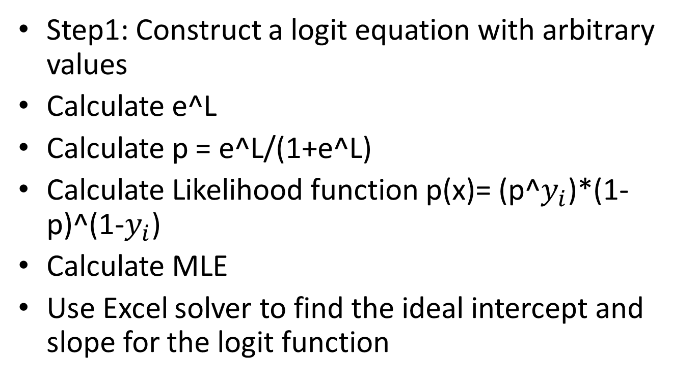
Binary Regression in excel
Step1: Construct a logit equation with arbitrary values
Calculate e^L
Calculate p = e^L/(1+e^L)
Calculate Likelihood function p(x)= (p^$y_{i}$)*(1-p)^(1-$y_{i}$)
Calculate MLE
Use Excel solver to find the ideal intercept and slope for the logit function

Slide 21
Binary regression in excel - output
Logit = ln(p/1-p)= 0.0+0.2413* age
Intercept = 0
Slope = 0.2413

Slide 22
Step 2: Binary regression in excel with data grouping
In step 1 we did not group multiple instances of the same value- that is if there were multiple customer with the same age they were treated separately. This did not yield a presentable graph
So we decided to group the data for every data point in the predictor variable

Slide 23
Data view- grouped on data points
The data was grouped on each observed data point with a summary of positive and negative responses
Once again we did the regression analysis

Slide 24
Steps followed in stage2- Bayesian Binary Regression using Excel
Step1:Group the universe on data points found on the universe
Step2:Calculate the rate of success for each data point
Step3:Calculate the mean and SD response rate for the entire group of observations
Step 4:Form a ‘subjective’ prior with these observations where the prior is a normal distribution with the observed mean and SD of the response rate

Slide 25
Calculating the intercept and slope of the Logit
Draw a random sample from the universe of roughly 30 observations
Assume an arbitrary intercept and slope for the logit
Calculate the logit, probability and likelihood functions for each observation in the sample
Calculate the MLE {Product of all LE}
Use Excel solver to get the optimum values for the intercept and slope

Slide 26
Predicting the Bayesian probability
Apply the logistic equation to all the values in the universe
Generate the data for the prior using a normal distribution and a random function
Multiply the likelihood by the prior to arrive at the BBR predicted probability

Slide 27
Step 2 - results
Intercept and slope in yellow boxes
BBR in red column and Logistic Regression prediction by Excel

Slide 28
Predictions- comparison LR with BBR
Excel prediction based on Logistic Regression on the red line
Excel based BBR prediction on the blue line
BBR predictions produced lower values of predictions as a whole

Slide 29
Bayesian Binary vs Logistic groupwise comparison – excel generated
Observations grouped on observed datapoints
Compares BBR vs LR based on Excel generation

Slide 30
Step 3: Using R
newsub<-read.table(file.choose(),header=TRUE)
newsub
attach(newsub)
CW<-cbind(Yes,Total-Yes)
CW
logrl<-glm(CW~Age,family=binomial)
summary(logrl)
qchisq(0.95,16)
exp(0.03258)
(1.033117-1)*100
plot(Age,fitted.values(logrl))
points(Age,Yes/Total,col="red",+)
points(Age,Yes/Total,col="red",pch=4)
Code snippet used for regression in R
The grouped data was fed into R
And binary regression was performed using R

Slide 31
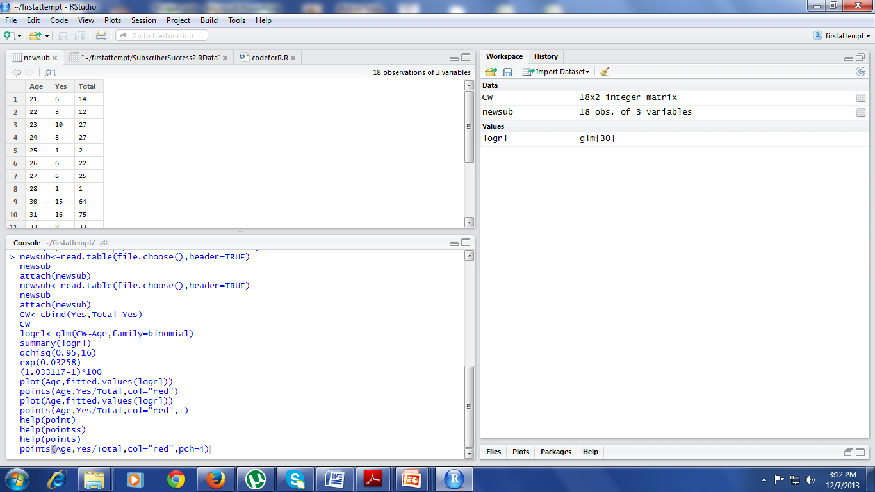
R window

Slide 32
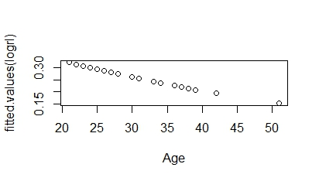
Results Binary regression in R
Intercept= -0.619
Slope= -0.03258
Logit= -0.619 -0.03258* Age

Slide 33
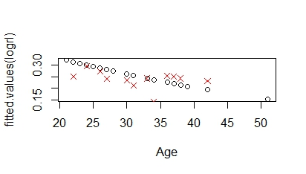
Predicted versus observed values
The red crossed line is the observed values
The black circles show the line fitting by regression
The line indicates a negative relationship between the logit and age

Slide 34
Inputting R output into excel based prediction
The line fitting from R was fed into Excel
The intercept and slope values were used to calculate the all the values as in the preceding case
The BBR was then calculated using the formula posterior= prior X likelihood
The results were compared

Slide 35
Results from R and BBR
Intercept and slope( from R) in yellow box
BBR prediction in blue and R based logistic prediction in Red

Slide 36
BBR prediction curve in blue
R+excel based LR prediction in Red
There seems to be a closer relationship between the logistic predictions and BBR predictions based on R

Slide 37
Bayesian Binary vs Logistic groupwise comparison – R and excel generated
Observations grouped on data points
Manipulations in R and excel combined

Slide 38
Step4 Bayesian Binary in Matlab
In the final step we attempted the binary regression using the Bayes formula in Matlab
The grouped data were used as the input
Data points in the predictor variable : Age
Age = [21 22 23 24 25 26 27 28 29 30 31 33 34 36 37 38 39 42 51]';
The number of customers tested at each age
total = [14 12 27 27 2 22 25 1 64 75 33 28 59 20 33 6 43 15]';
The number of customers that responded at each age
success = [6 3 10 8 1 6 6 1 15 16 8 4 15 5 8 3 10 1]';

Slide 39
Logistic regression was calculated using the equation:
logitp = @(b,x) exp(b(1)+b(2).*x)./(1+exp(b(1)+b(2).*x));
prior1 = @(b1) normpdf(b1,0,20);
prior2 = @(b2) normpdf(b2,0,20);
Posterior equation :
post = @(b) prod(binopdf(success,total,logitp(b,Age))) * prior1(b(1)) * prior2(b(2));

Slide 40
Plotting the posterior
b1 = linspace(-2.5, -1, 50);
b2 = linspace(3, 5.5, 50);
simpost = zeros(50,50);
for i = 1:length(b1)
for j = 1:length(b2)
simpost(i,j) = post([b1(i), b2(j)]);
end;
end;
mesh(b2,b1,simpost)
xlabel('Slope')
ylabel('Intercept')
zlabel('Posterior density')
view(-110,30)

Slide 41
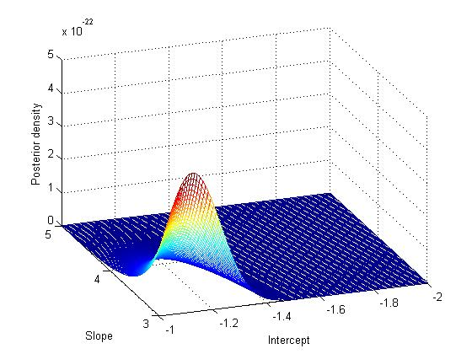
Output

Slide 42
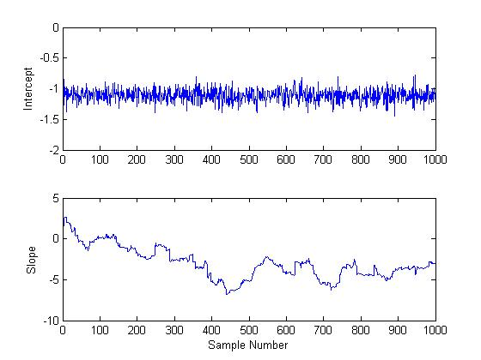

Slide 43
Conclusions
Our experiment with binary regression and Bayes binary regression has produced similar but significantly different results
Age does not seem to be strongly related to the subscription decision as the slope parameter is too small
As such while we can fit the line to predict the probability it does not result in reducing the target size for the campaign
Perhaps the study can be repeated at a later date with more variables including geography and income

